Slide 1
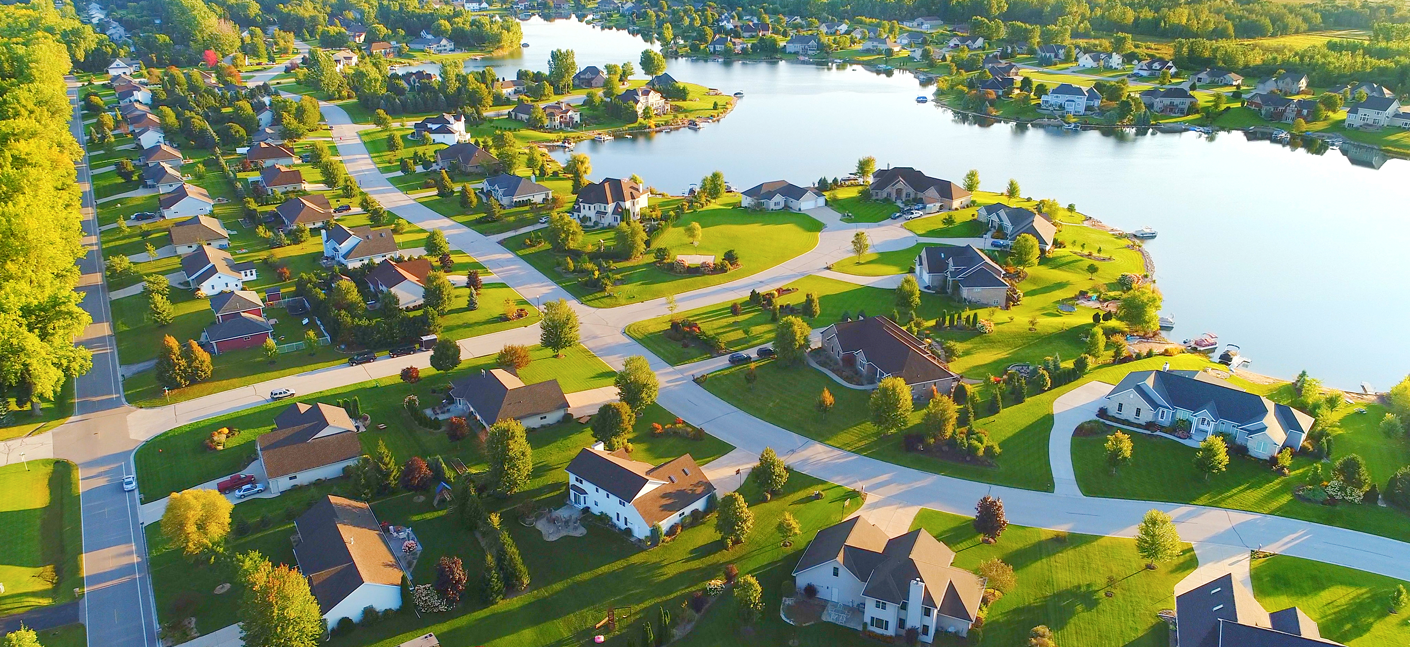
Ames, Iowa Residential Property Sales
Insights gleaned from a thorough analysis of 2053 residential properties sold
between 2006-2010 in Ames, Iowa
Notes:
NOTE: Want a different image on this slide? Select the picture and delete it. Now click the Pictures icon in the placeholder to insert your own image.

Slide 2
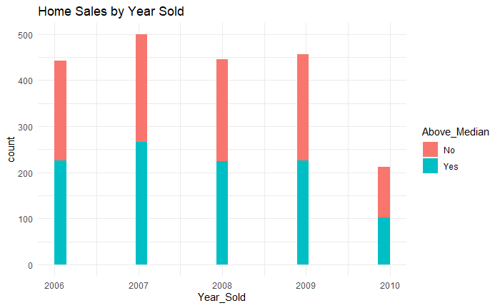
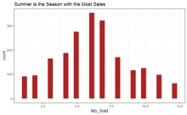
This is a balanced data set; regardless of the year sold, about half the houses (1043) sold above median price and half (1010) sold below median price.
Percentage Per Year
2006 2007 2008 2009 2010
Below Median 49% 47% 50% 50% 52%
Above Median 51% 54% 50% 50% 48%
All our analyses are trying to predict sale price above or below median sale price.
Both the table and the graph show us that year sold did not predict the house value being above or below median. Also, note that there were fewer sales in 2010.
Interestingly, more homes sell in Summer than other seasons.

Slide 3
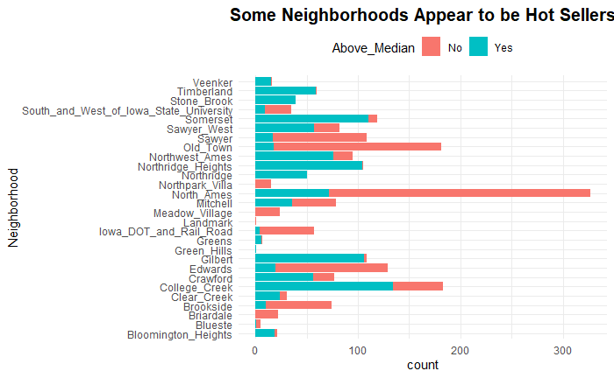
Location, location! Neighborhood can help predict whether a home will sell above median price
118 homes sold in Somerset and 92% were above median sale price
104 homes sold in Northridge Heights and 99% of them were above median sale
326 homes sold in North Ames and 22% were above median (78% were below)
127 homes sold in Edwards and 14% were above median sale price

Slide 4
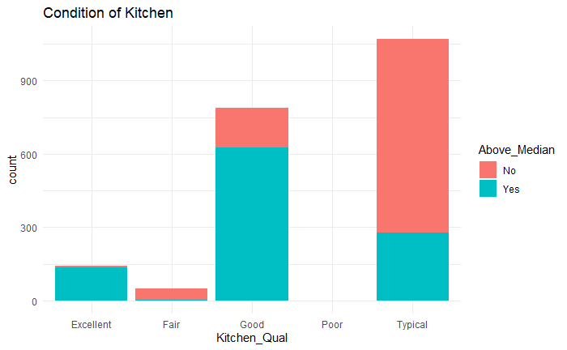
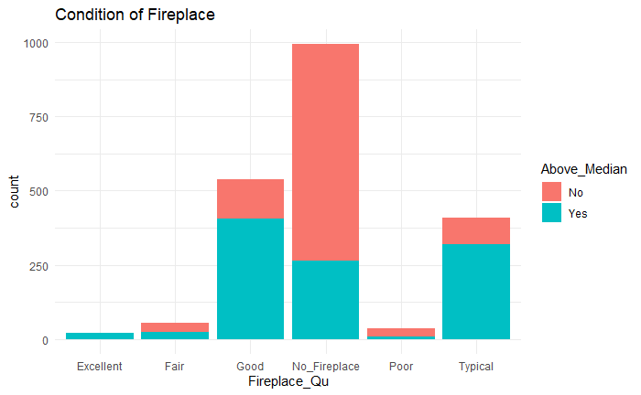
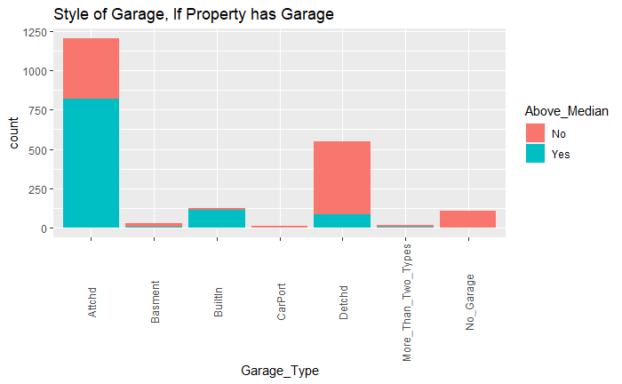
What are some features which predict that a house is more likely to sell above the median?
Kitchens
Excellent kitchens sell above median often more than below median
Same is true for a kitchen categorized as good
But a kitchen categorized as typical or fair more often sells below median sale price (all statements are visualized in the bar graphs below)
Fireplaces
Fireplaces categorized as excellent sell above median sale price more often than below
Fireplaces categorized as good, also sell above median
The same is true for typical fireplaces, however no fireplace at all is a predictor of selling below median.
Garages
Attached or built-in garages more often sell above median than below
Having no garage is a predictor of selling below median.
Having a detached garage is also a predictor of selling below median.
Winters in Iowa are cold, built in and attached garages are advantageous!

Slide 5
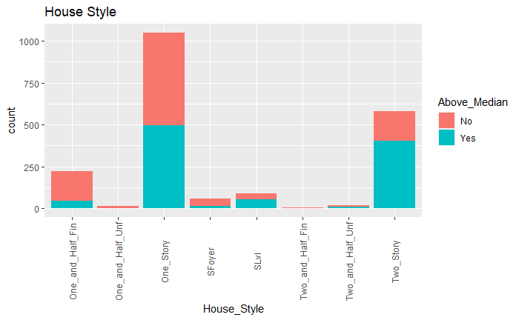
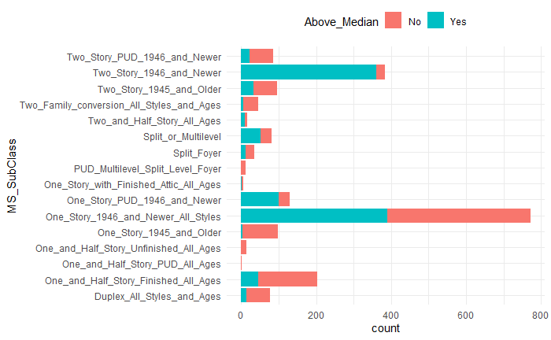
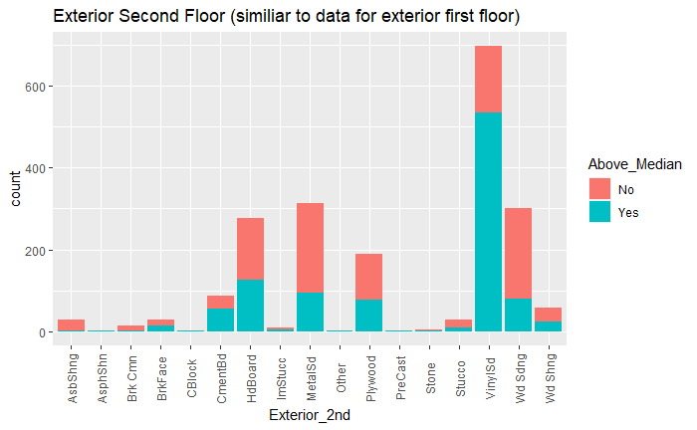
There is predictive value in looking at the style and the age of the house. For example, 94% of the two story homes newer than 1946 sold above median sale price (360x out of 383).
Categories with more counts help us accurately identify trends; categories with low counts are a statistically smaller part of the dataset.
Style and Age of House | Number Sold
One_Story_1946_and_Newer_All_Styles | 772
Two_Story_1946_and_Newer | 383
One_and_Half_Story_Finished_All_Ages | 204
One_Story_PUD_1946_and_Newer | 129
One_Story_1945_and_Older | 98
Two_Story_1945_and_Older | 95
Two_Story_PUD_1946_and_Newer | 85
Split_or_Multilevel | 82
Duplex_All_Styles_and_Ages | 76
Two_Family_conversion_All_Styles_and_Ages | 46
Split_Foyer | 34
Two_and_Half_Story_All_Ages | 17
One_and_Half_Story_Unfinished_All_Ages | 13
PUD_Multilevel_Split_Level_Foyer | 12
One_Story_with_Finished_Attic_All_Ages | 6
One_and_Half_Story_PUD_All_Ages | 1
Looking at house style: over 1000 sales were of one story houses and that is not a predictive variable because half sold above median and half below.
House style variable is predictive in the other categories: seen here in two story houses being predictive of selling above.

Slide 6
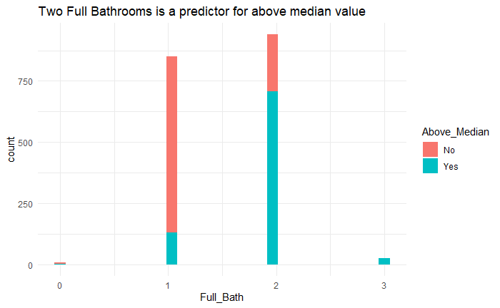
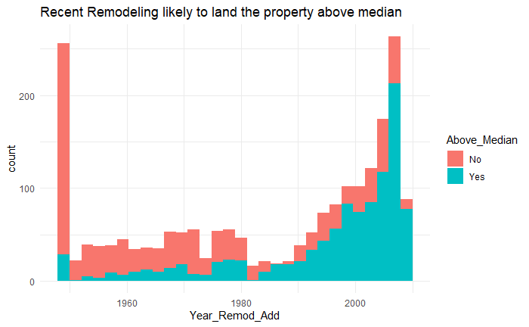
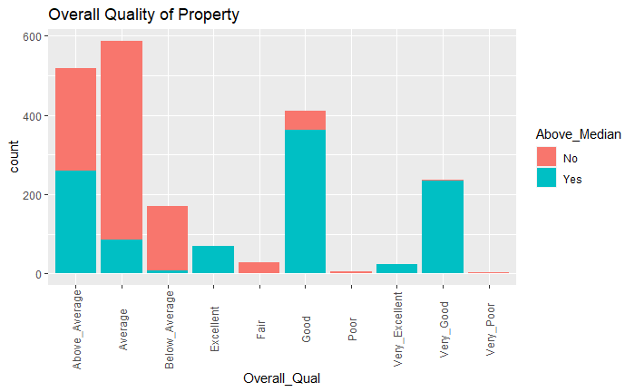
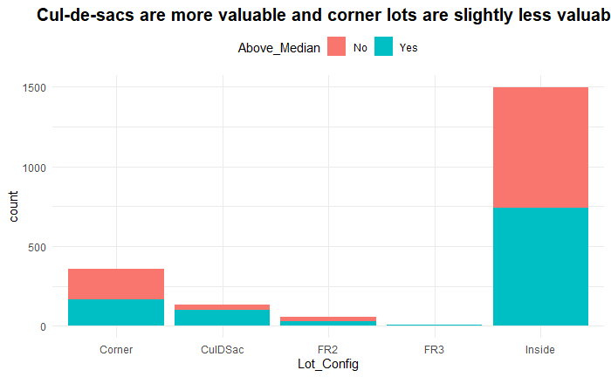
Overall quality, remodels, cul-de-sacs and of course, bathrooms are predictive
77% of the houses with 2 bathrooms sold over median price.
Recently remodeled homes sell above median more often than older homes or never remodeled homes.
Most numerous are homes with interior lots and 50.5% of the time they sell below median. So, inside lots have no predictive value, it's 50/50 whether they sell above or below.

Slide 7
In our data, the following variables are strong predictors of a home selling above the median sale price.
Style and age of the home First floor square footage
Neighborhood Number of full bathrooms
Zoning of the home Remodeled year
Overall quality of the home Heating system quality
Overall condition of the home Fireplace quality
Exterior material of the first floor
Exterior material of the second floor
Exterior quality
Type of exterior materials
Foundation style
Garage style
Basement quality
Basement finish type
Kitchen quality
Some variables contained unusual situations, otherwise known as outliers. An example of such from this dataset was a home having no public sewer (there was one such home in the dataset) or a home having a gravel street. When such outliers comprised less than 1% of the data, the variable was deleted as it had no predictive value.
Some variables had no predictive value as they identified equal likelihood of selling above or below median, these too are filtered out of our dataset.

